Slide 1
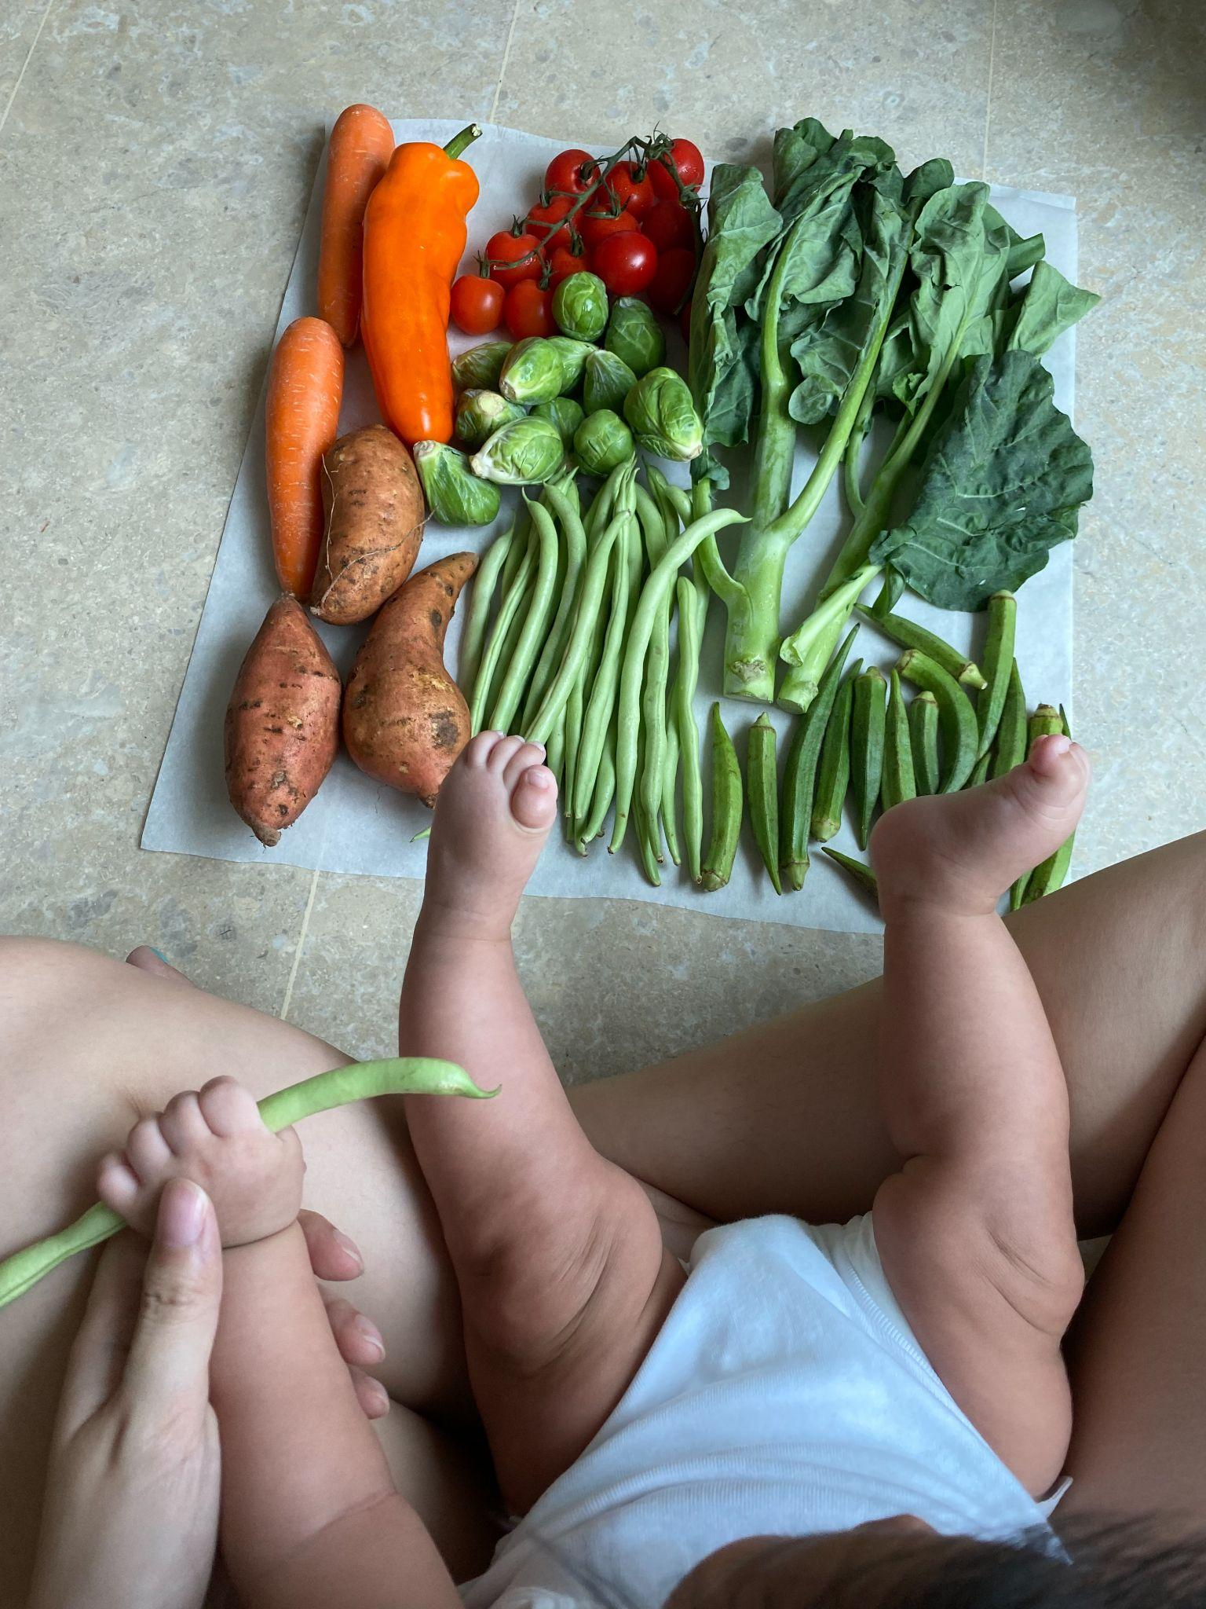
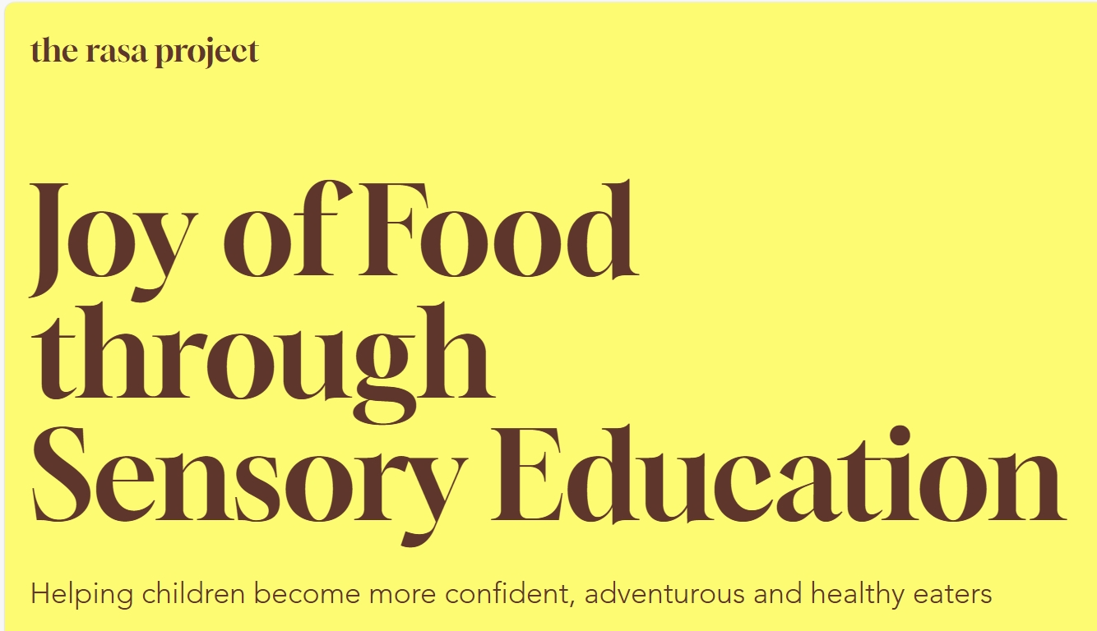
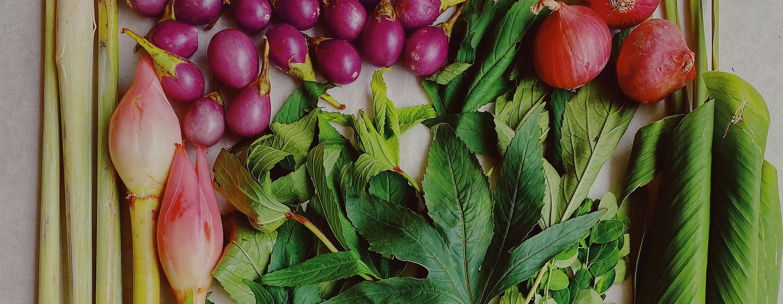

Slide 2
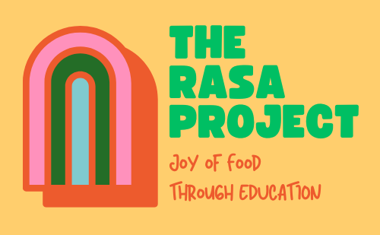
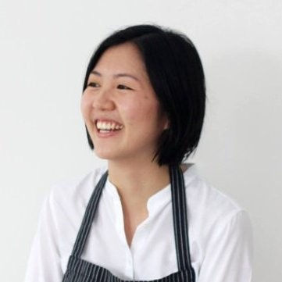
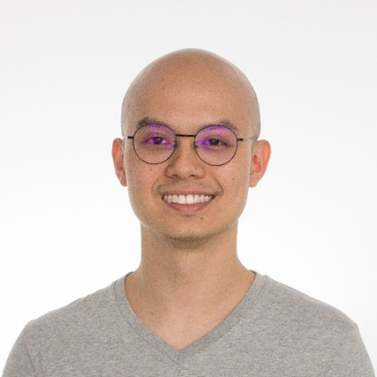
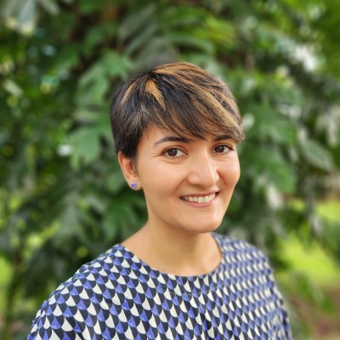
The Rasa Project (est 2025) : Rasa means Taste in Malay
IMPRONG FOOD TOGETHER
1 in 2 parents identified their children as picky eaters
(KKH, 2023)
Increase of families and also a top reason of using screen time for a fuss free meal
(NUH, 2024)
Childhood obesity is on the rise from 13% to 16%
(KKH, 2021)
Tan Mei Wan Co-founder
Jonathan Yeow Co-founder
Board Member Director of Sustainability, APAC and EME, Compass at Google

Slide 3
IMPRONG FOOD TOGETHER
Why do we need more food education
in Singapore ?
1 in 2 parents identified their children as picky eaters
(KKH, 2023)
Increase of families and also a top reason of using screen time for a fuss free meal
(NUH, 2024)
Childhood obesity is on the rise from 13% to 16%
(KKH, 2021)

Slide 4
Why do we need more food education in Singapore ?
Total amount of food waste generated in 2024 was 784,000 tonnes (approx 130 kg/person)
(NEA)
Singapore imports 90 %+ of its food, so wasted food = wasted imports, fuel, emissions
All food waste must be burned, which contributes to carbon emissions. Singapore has no landfill space for organic decomposition because of land scarcity.

Slide 5

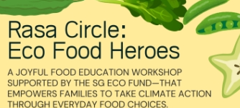
How The Rasa Project Aligns with Singapore’s National Goals
Sustainability, Food Security & Waste
Education & Early Childhood Dev
Public Health & Nutrition
Reduce the amount of waste to landfill per capita per day by 30% (by 2030)
Local farms to supply 20% of the local consumption of fibre and 30% of the local consumption of protein by 2035
Public Health & Nutrition
My Healthy Plate: Protein: Consume 2 to 3 servings of protein per day. Fruits and Vegetables: Fill half your plate with fruits and vegetables at each meal
To ensure every child has access to affordable and quality early childhood development services and programmes
Works with Health Promotion Board following My Healthy Plate standards
Education & Early Childhood Development
In discussion with Health Promotion Board (under Ministry of Health)

Slide 6
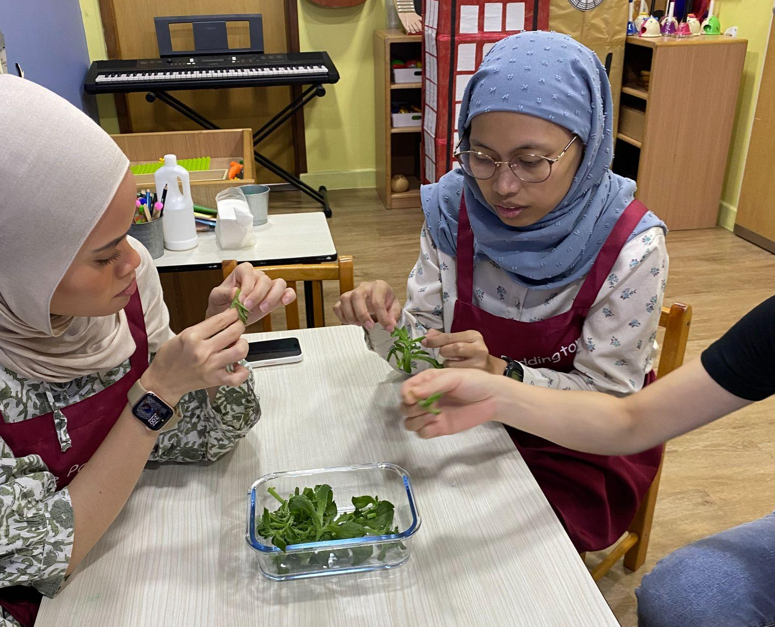
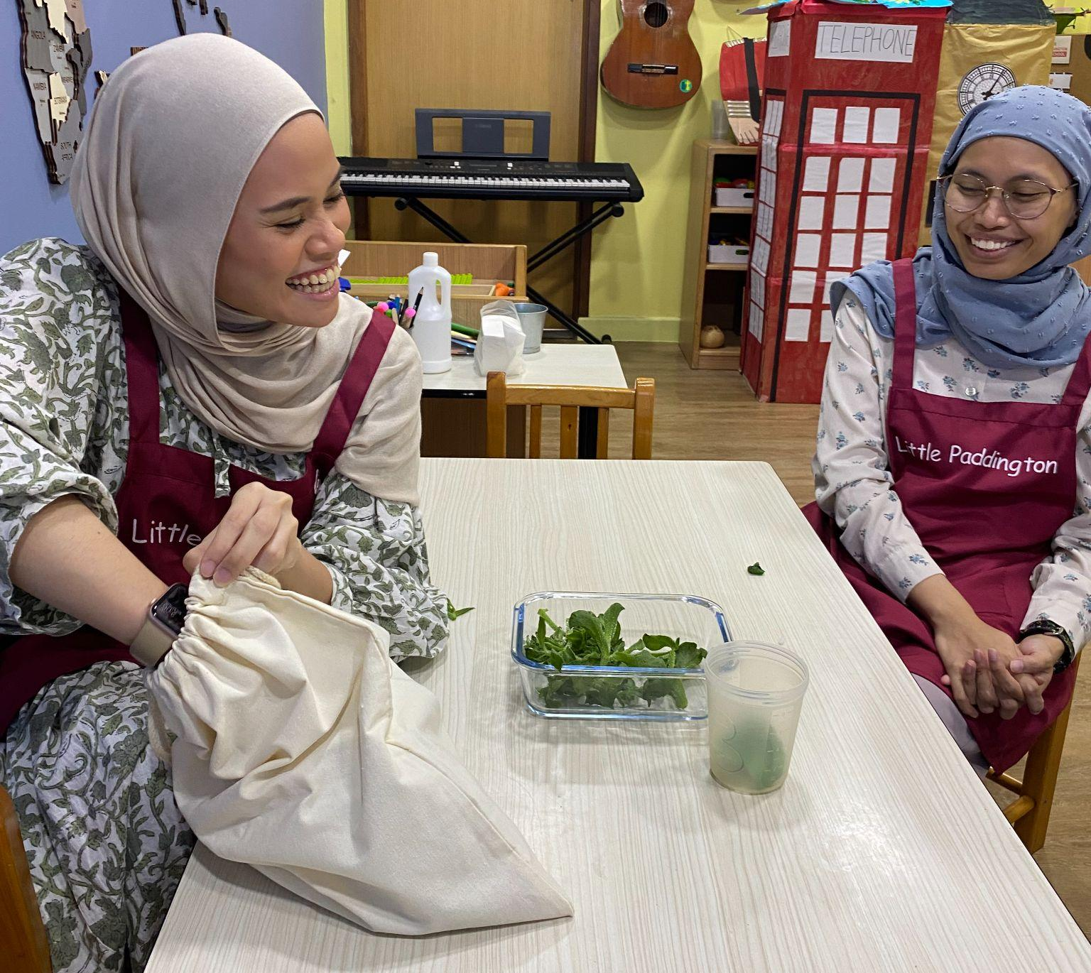

Slide 7
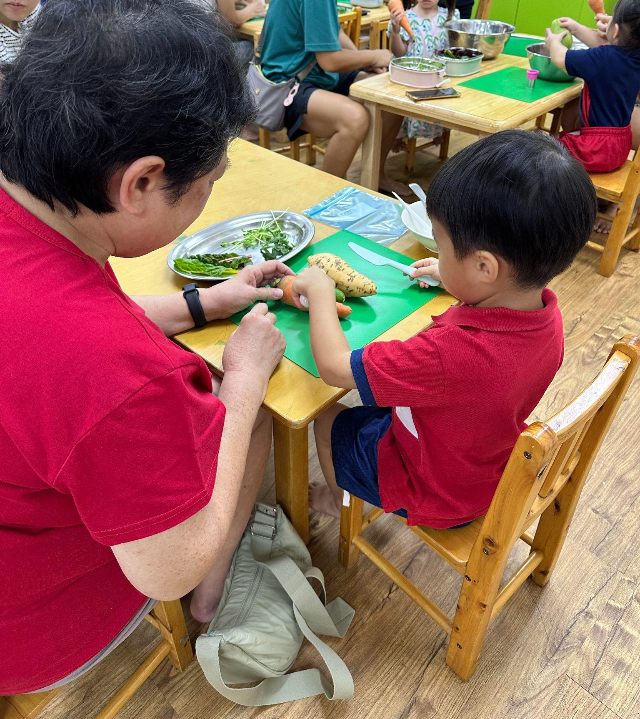
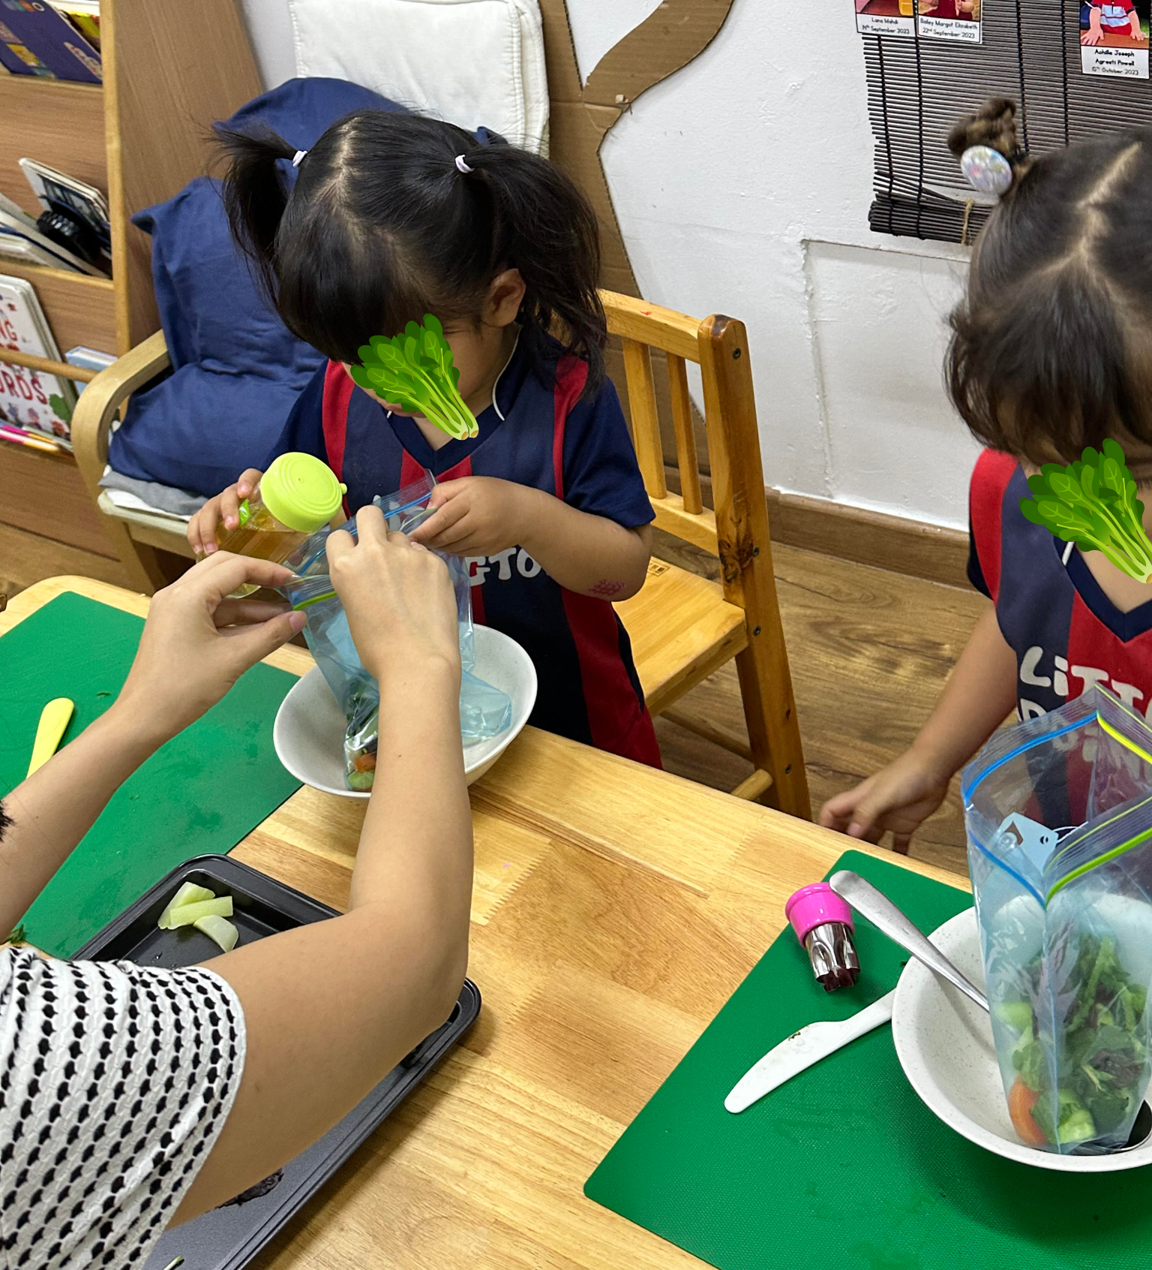

Slide 8
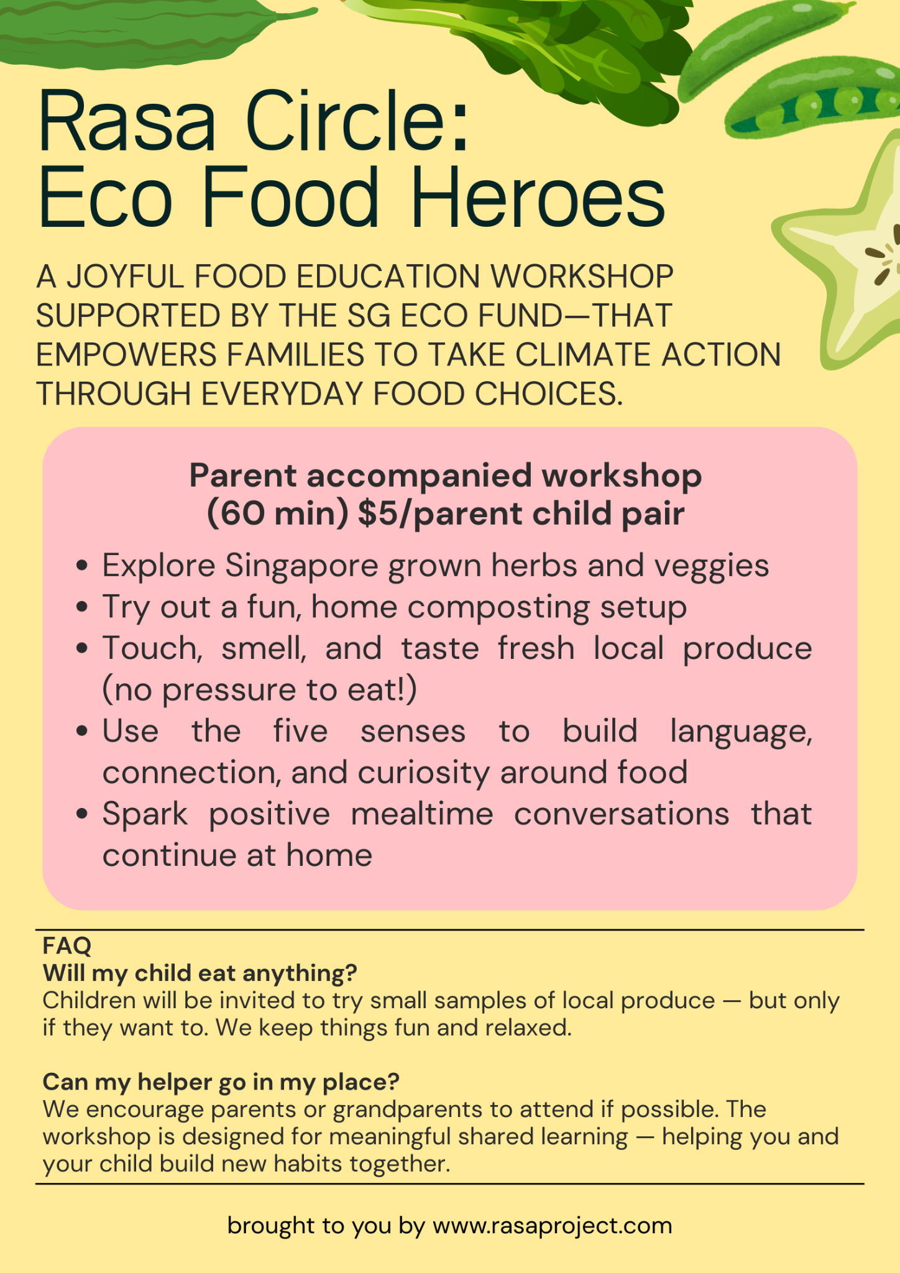
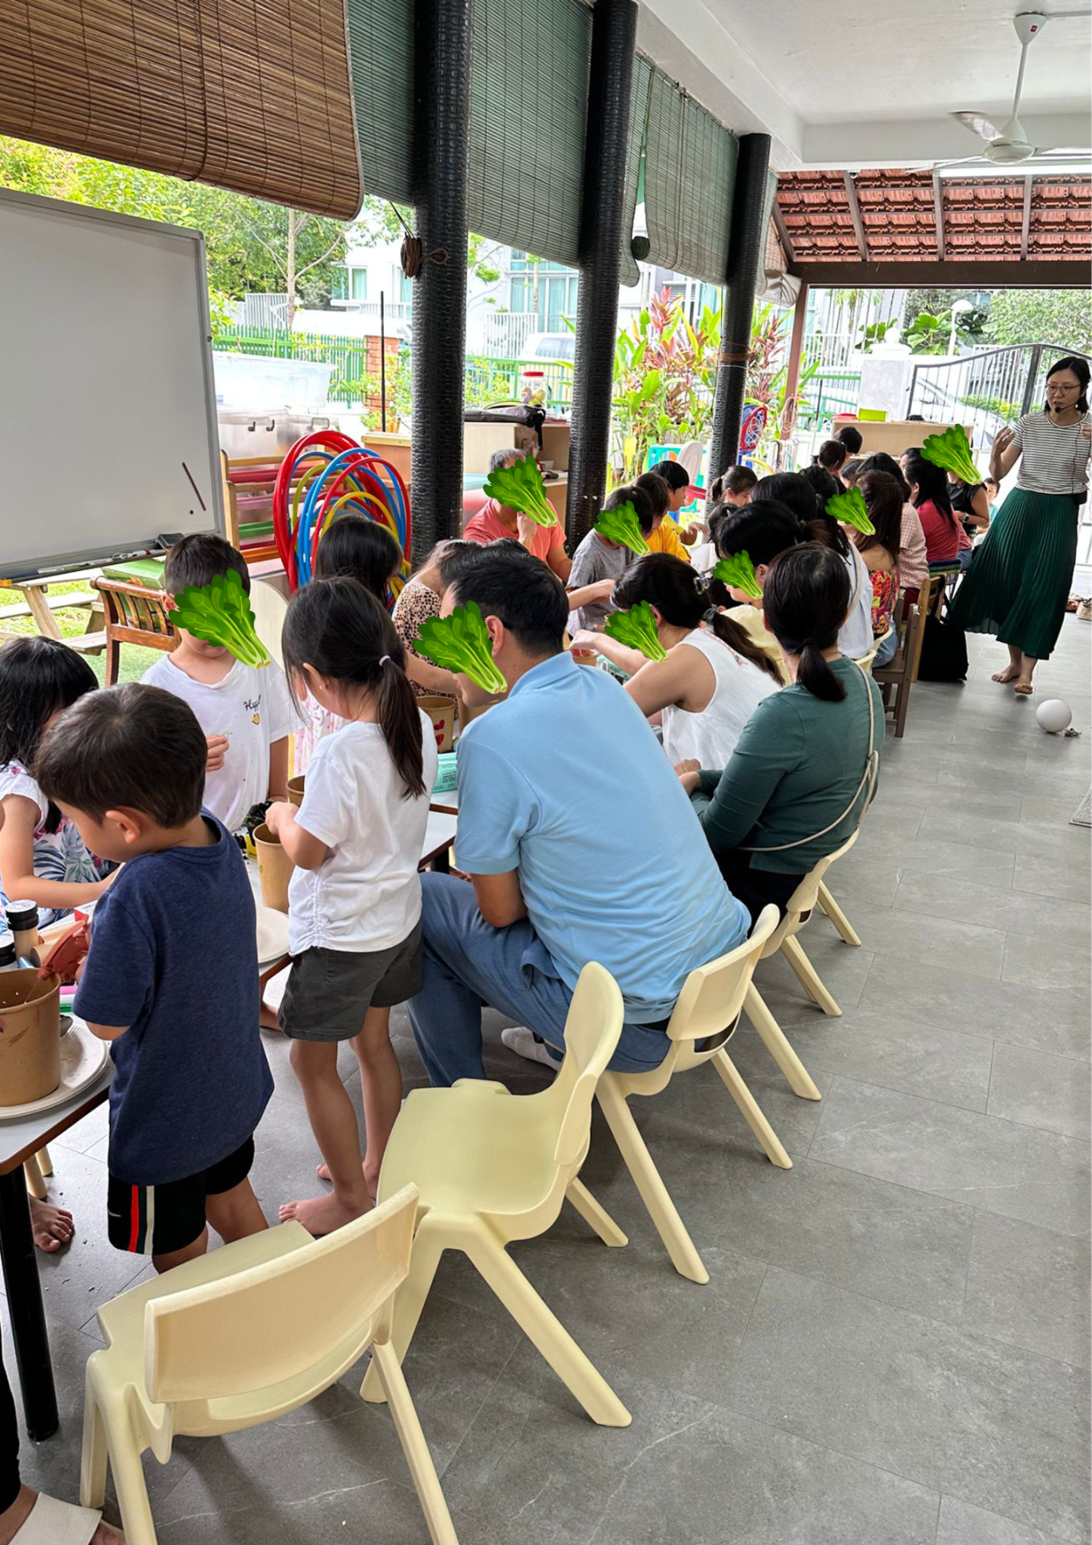

Slide 9
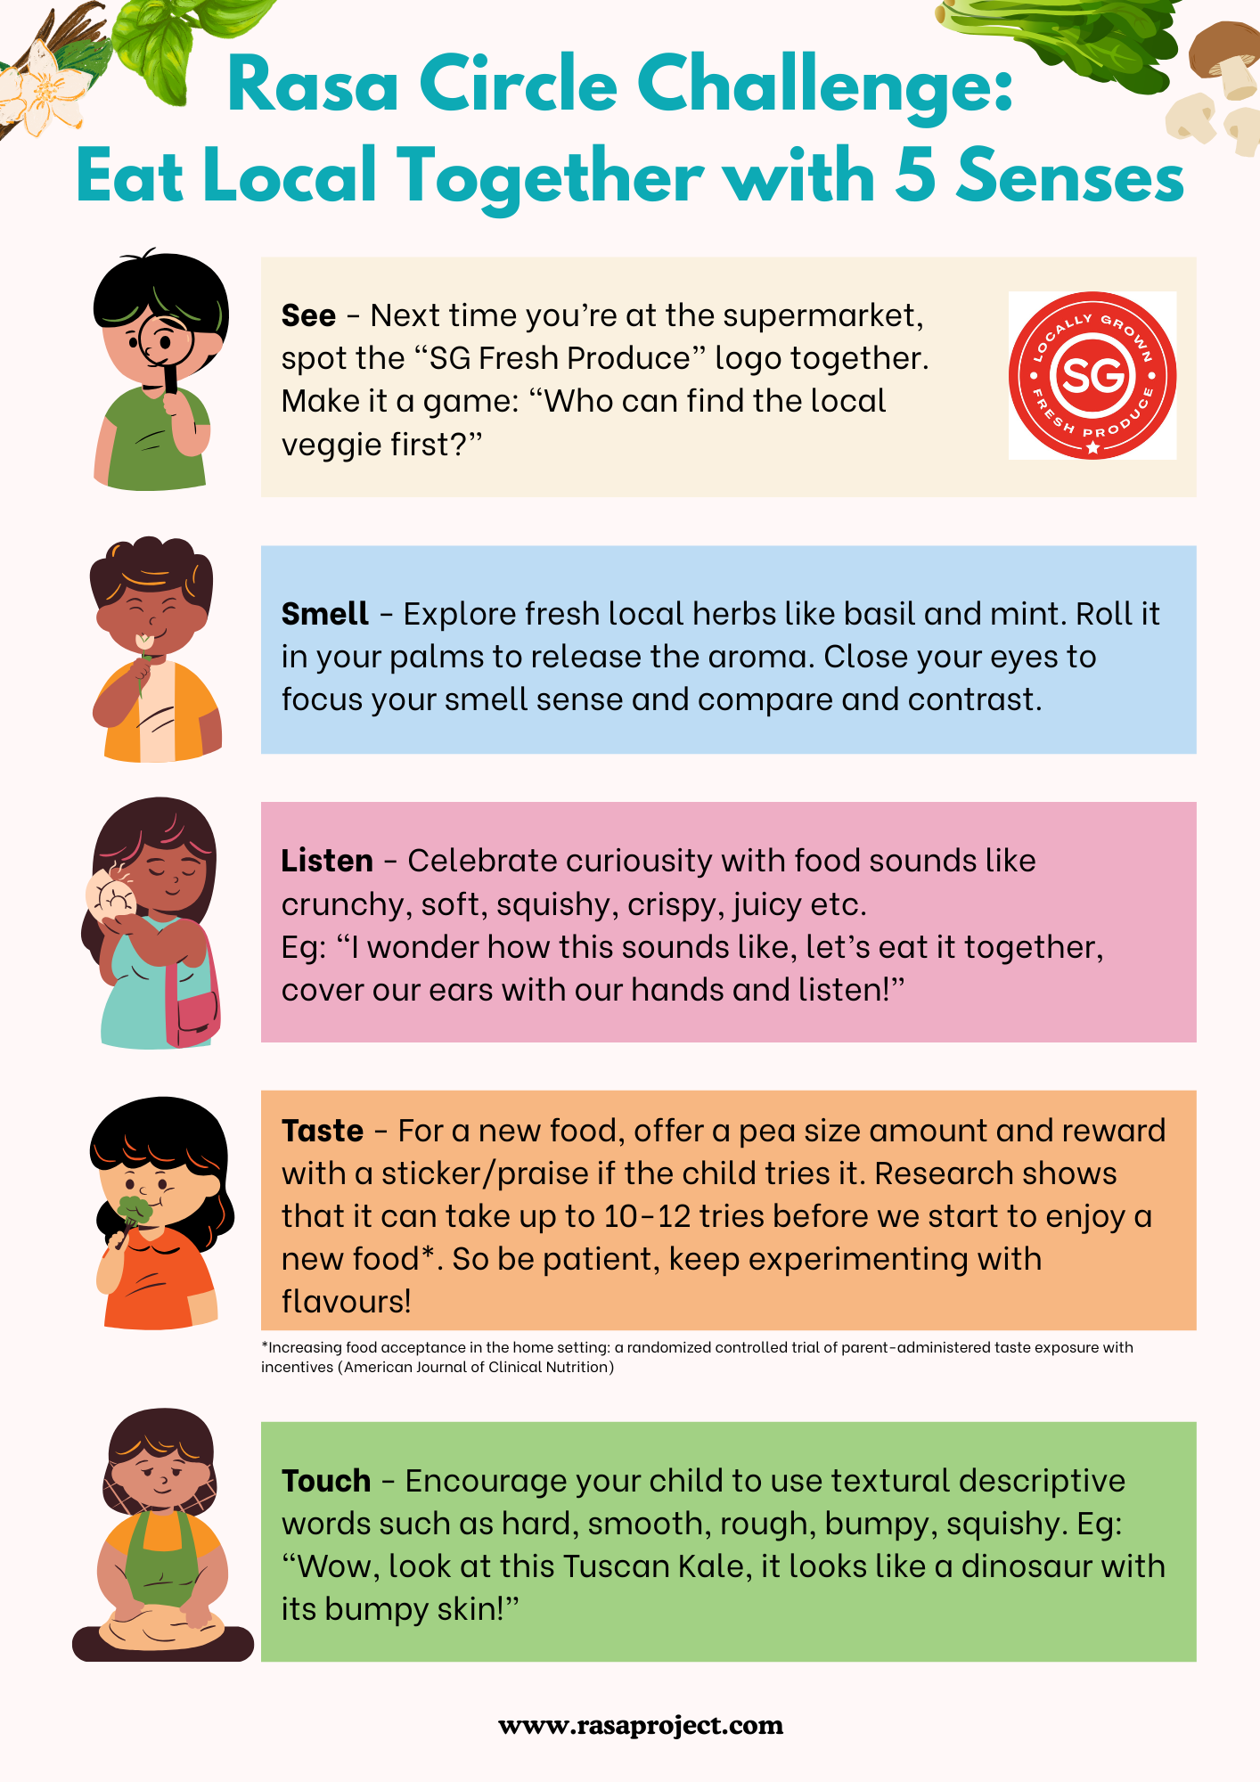
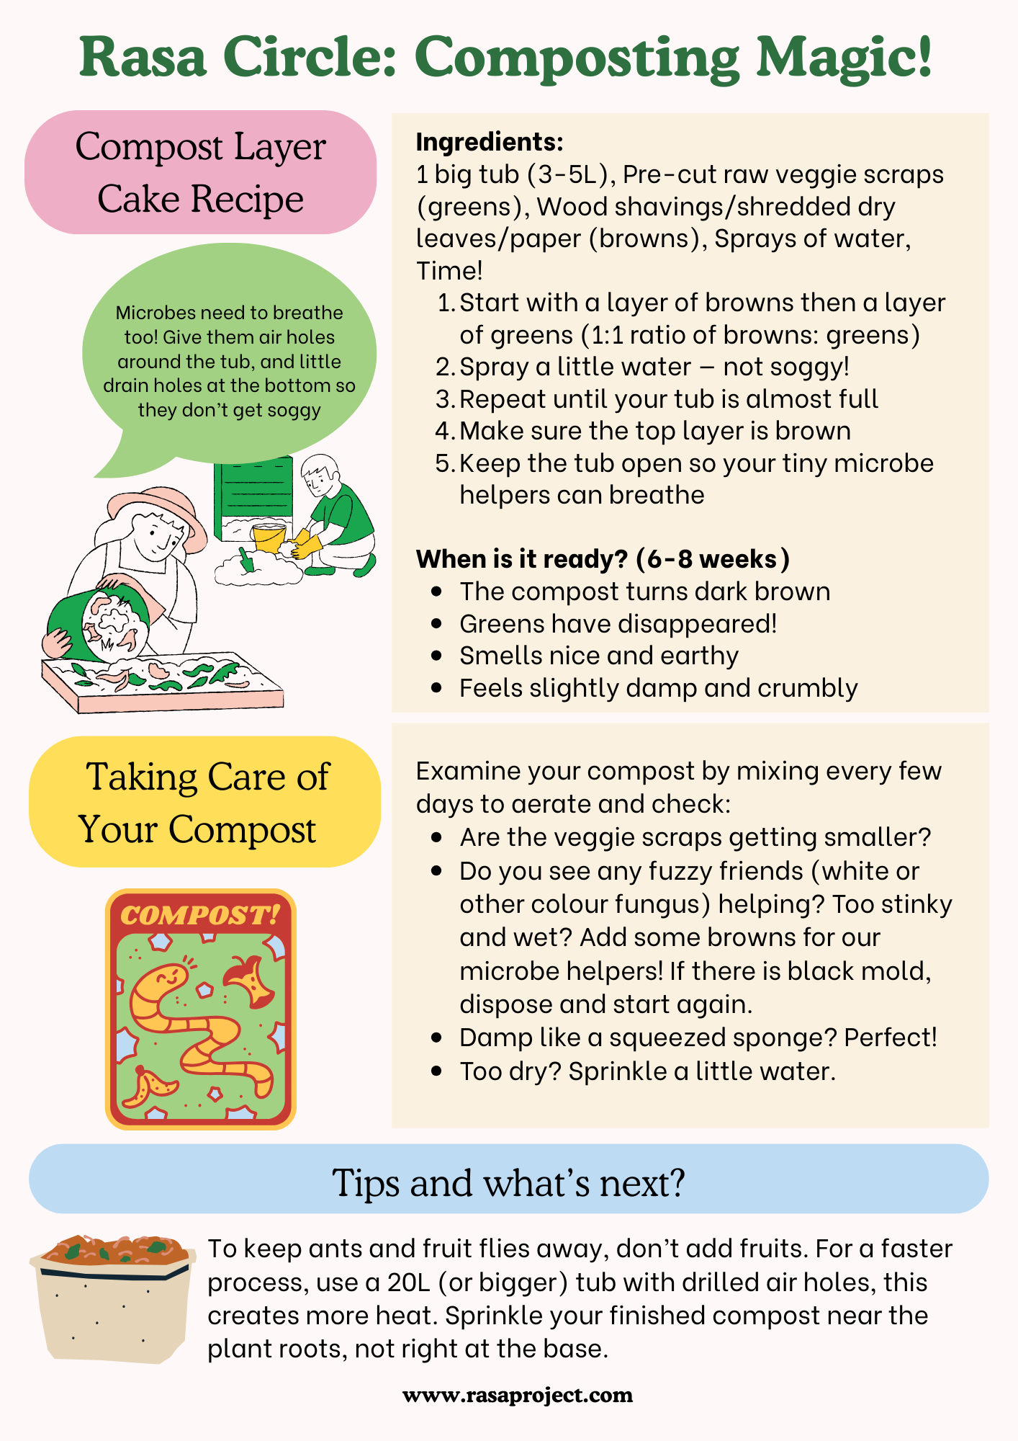

Slide 10
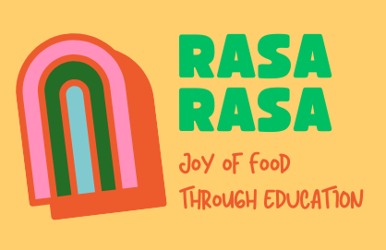
The Rasa Project x Singapore Eco Fund
Children will explore and may taste raw and dried vegetables & herbs, such as rainbow chard, lettuce, ice plant, shiitake mushrooms, alfalfa sprouts, kale, vanilla, pandan, mint, lemongrass, and kaffir lime. Exploring how to incorporate local eggs and seafood.
Age: 18m-2, 3-4 or 5-6
Capacity per workshop : 18-20 kids with parents
45 workshops to impact 1700 participants
Surveys, post workshop and another 6-8 weeks later to check on progress

Slide 11
Collaboration (email us at learn@rasaproject.com)
Our hope is to not only exchange knowledge, but to build bridges — connecting SAPERE’s evidence-based tradition with Singapore’s growing commitment to health and sustainability. Our bold long term goal is to raise greater awareness across Southeast Asia, where Singapore can serve as a regional catalyst for food education.
Research & Knowledge Sharing
Sharing of evaluation tools, and studies measuring sensory food education outcomes
Guidance on how to communicate evidence to policymakers — especially framing sensory learning as part of public health and early childhood wellbeing
Mentorship & Peer Learning
Informal mentorship from experienced SAPERE educators and researchers
Peer learning exchanges between Rasa facilitators and experienced practitioners
Feedback on curriculum design, educator training, and long-term evaluation

Slide 12
Concurrent Efforts
Digital presence with resources for parents & educators
Fundraising, establishing as charity and team + volunteer programme building
SG Government relationship building for longer term goals (white paper, future projects/grants)

