Slide 1
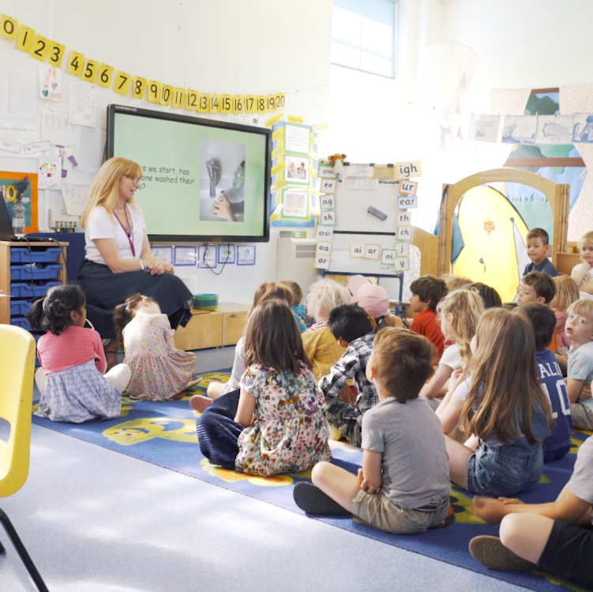

TastEd: making food education accessible
National UK charity bringing sensory food education to schools and early years settings
Free, curriculum-linked lessons & activities (aged up to 11)
Focus on fresh fruit & vegetables – simple, no kitchen needed
~1,800 schools and nurseries signed up

Slide 2
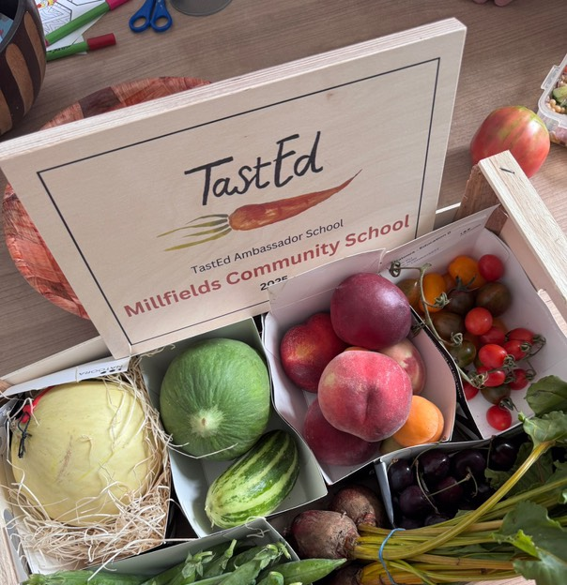
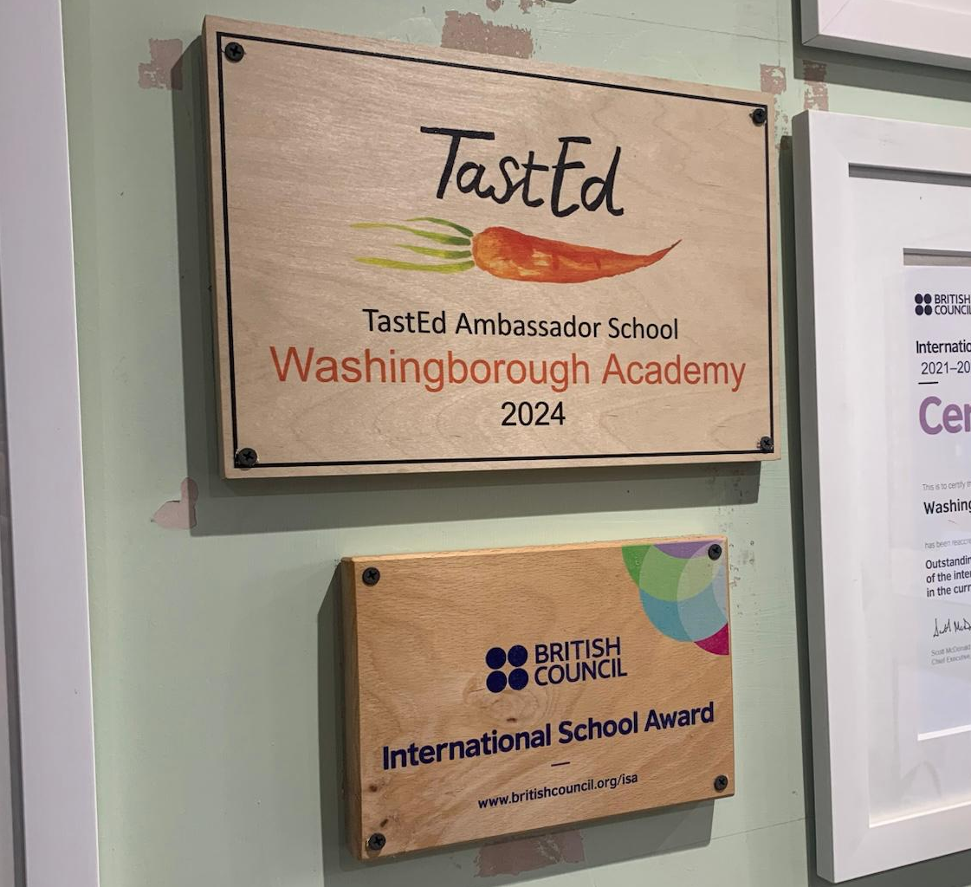
TastEd Ambassador Schools
Celebrating 5 schools leading the way in embedding TastEd
Sharing case studies, children’s work, and teacher voices

Slide 3
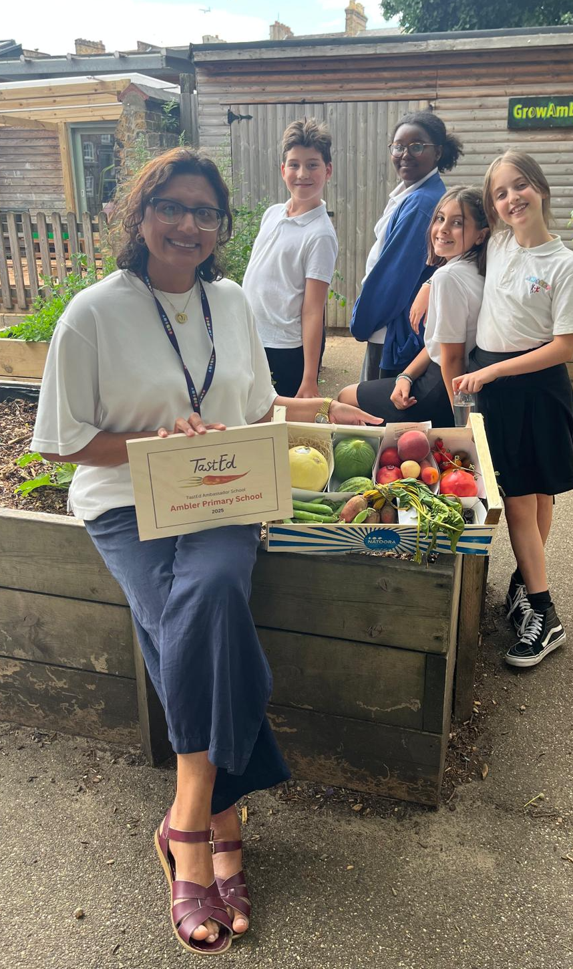
Ambler Primary School &
Children’s Centre
TastEd provision from nursery – year 6
Children are more adventurous at lunchtime – a sudden love of beetroot!
UK central government Department for Education’s Early Years Safeguarding, Health and Wellbeing team visit to see TastEd in action

Slide 4
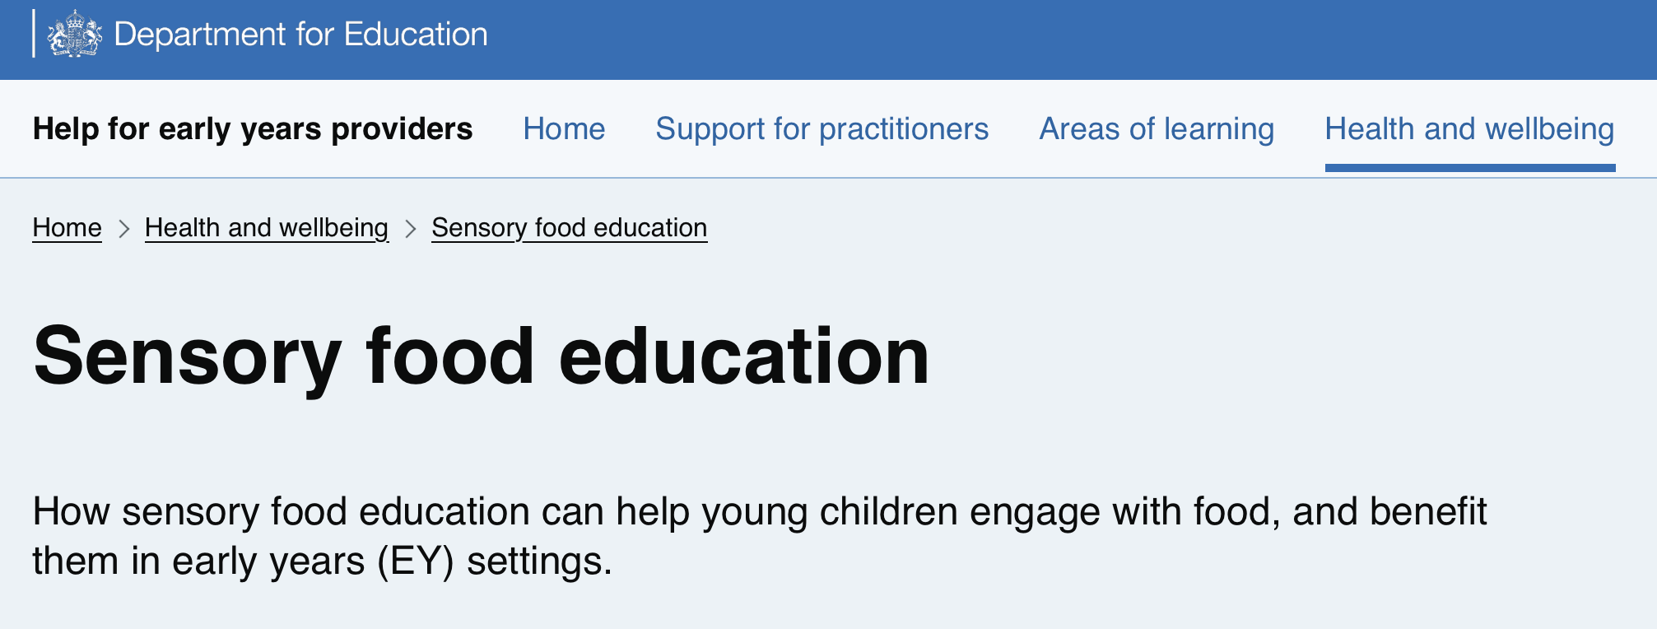
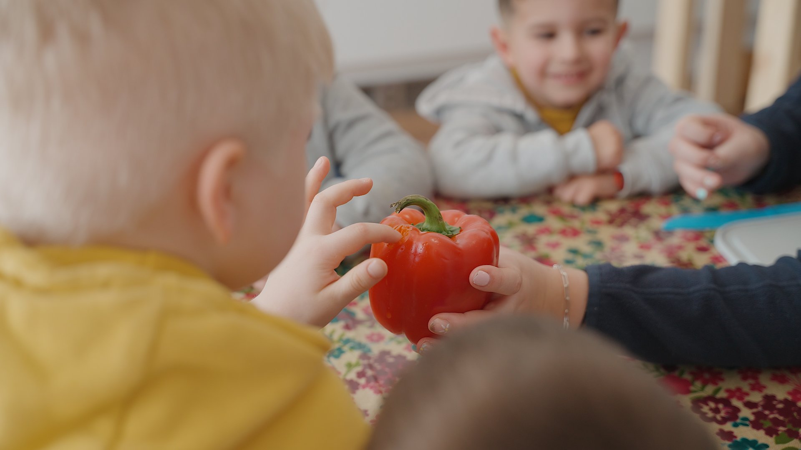
Looking ahead
Featured in Department for Education Early Years Health & Wellbeing guidance
Referenced in the National Food Strategy and the governments Good Food Cycle.
Goal: Every child in the UK experiences the joy of tasting fresh vegetables

Slide 5
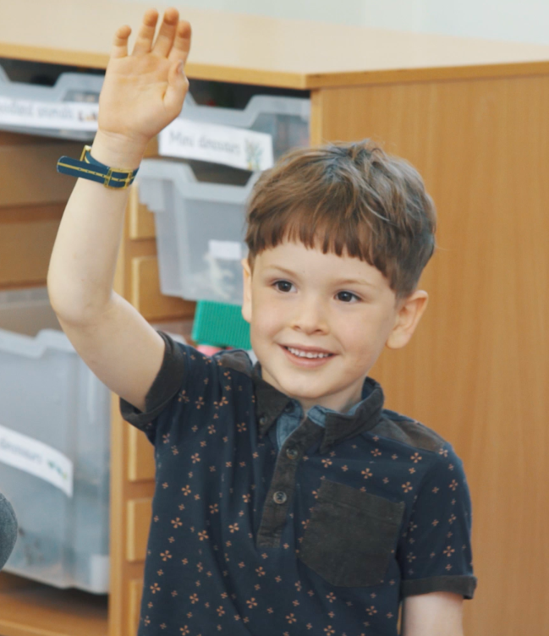
Any questions?

Slide 6
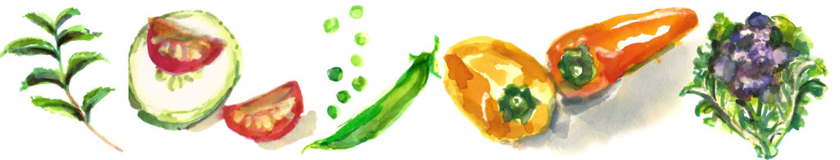
Thank you for listening…
To keep up to date with what’s going on at TastEd:
Sign up to our newsletter: www.tasteeducation.com
Follow up on social media:
Instagram: @tasted_feed
LinkedIn: TastEd

